Slide 1
PSCS_46_Application for Assessment of Quality of Textbook/Reference Books/E-Book
CSE7101- Capstone Project
Review-1
Batch Number: CSE_169
Under the Supervision of,
Mr. Md Zia Ur Rahman
Assistant Professor
School of Computer Science and Engineering
Presidency University
20221CSE0392 | LAVANYA M
20221CSE0266 | POSINA SUPRAJA
20221CSE0385 | TALLURU CHETHANA
Roll Number | Student Name
Name of the Program: Computer Science and Engineering
Name of the HoD: Blessed Princy
Name of the Program Project Coordinator: Mr. Muthuraj
Name of the School Project Coordinators: Dr. Sampath A K , Dr. Geetha A

Slide 2
Problem Statement Number: PSCS_46
Organization: Ministry of AYUSH
Category (Hardware / Software / Both) : Software
Problem Description: The "Application for Assessment of Quality of Textbook/Reference Books/E-Book" is a web-based platform designed to evaluate the quality of academic and reference materials through structured feedback from authorized reviewers such as faculty members or subject experts. The system enables reviewers to log in, submit book details, and assess them based on predefined parameters including content relevance, accuracy, clarity, up-to-date information, and presentation. It automatically calculates an overall quality score using parameter-based weightages and generates summary reports for administrators. By replacing the manual, time-consuming, and inconsistent evaluation process with a standardized, automated, and data-driven approach, the application ensures transparency, efficiency, and better decision-making in selecting learning resources. Key features include reviewer authentication with role-based access, book submission and assessment forms, automated score computation, and summary dashboards with exportable reports, enabling institutions to maintain a centralized and reliable process for approving educational materials.

Slide 3
Content
Problem Statement
Objectives
Background and Related work for title Selection
Analysis of Problem Statement
Innovation or Novel Contributions
Git-hub Link
Timeline of the Project
References

Slide 4
Problem Statement
In academic institutions, the evaluation of textbooks, reference books, and e-books is often carried out manually by faculty members or subject experts. This process is time-consuming, lacks standardization, and is prone to inconsistencies and human bias. Feedback is usually stored in scattered formats, making it difficult to track, compare, or maintain historical records. Without a centralized and automated system, ensuring the quality, relevance, and up-to-date nature of learning resources becomes challenging. There is a need for a software-based solution that streamlines the evaluation process, standardizes scoring criteria, and generates transparent, data-driven reports for better decision-making in selecting academic materials.

Slide 5
Objectives
To develop a web-based platform for evaluating the quality of textbooks, reference books, and e-books.
To provide a standardized assessment framework with predefined quality parameters and weightages.
To enable secure reviewer authentication and role-based access control.
To automate the scoring and report generation process for quick decision-making.
To create a centralized database for storing book details, reviews, and historical records.
To ensure transparency, consistency, and efficiency in the evaluation process.

Slide 6
Background and Related work for Title Selection
Background
Quality of learning materials is critical for effective education.
Current evaluation methods are manual, slow, and inconsistent.
No centralized platform for storing and tracking book evaluations.
Increasing need for standardized and automated assessment systems.
Proposed application aims to digitize and streamline the process.
Related Work
Institutions often use rubrics, spreadsheets, or basic forms for evaluation.
Existing systems are part of large ERP platforms — costly and complex.
Research provides frameworks for quality parameters but lacks easy-to-use tools.
Limited standalone applications tailored for academic book assessment.
Our solution offers a lightweight, customizable, and automated platform.

Slide 7
Analysis of Problem Statement
Current Issue:
Manual evaluation is time-consuming, inconsistent, and lacks standardization.
Feedback is stored in scattered formats with no easy way to track or compare.
No automation for calculating scores or generating reports.
Decision-making is delayed due to lack of real-time data.
Impact:
Poor quality or outdated materials may be approved.
Administrative burden on faculty and staff.
Limited transparency and accountability.
Need:
A centralized, automated, and data-driven system for quality assessment.

Slide 8
Proposed Technology Stack
Frontend:
HTML5, CSS3, JavaScript – Basic structure and styling.
Angular – For building dynamic, responsive user interfaces.
Backend:
Node.js – Server-side logic and API handling.
Express.js – Lightweight framework for routing and backend structure.
Database:
MongoDB – NoSQL database for storing book details, reviews, and scores.
Authentication & Security:
JWT (JSON Web Tokens) for secure login and role-based access control.
Other Tools:
Chart.js / D3.js for report visualization.
Git & GitHub for version control.

Slide 9
Innovation and Novel Contributions
Standardized Evaluation Framework with predefined parameters and weightages.
Automated Scoring & Real-Time Reporting for faster decision-making.
Centralized Review Database for storing and retrieving past evaluations.
Role-Based Access Control for secure reviewer and admin operations.
Customizable Parameters to adapt evaluation criteria as per institutional needs.

Slide 10
Github Link
https://github.com/Lavanya7004/Quality-Assesment-Capstone Project

Slide 11
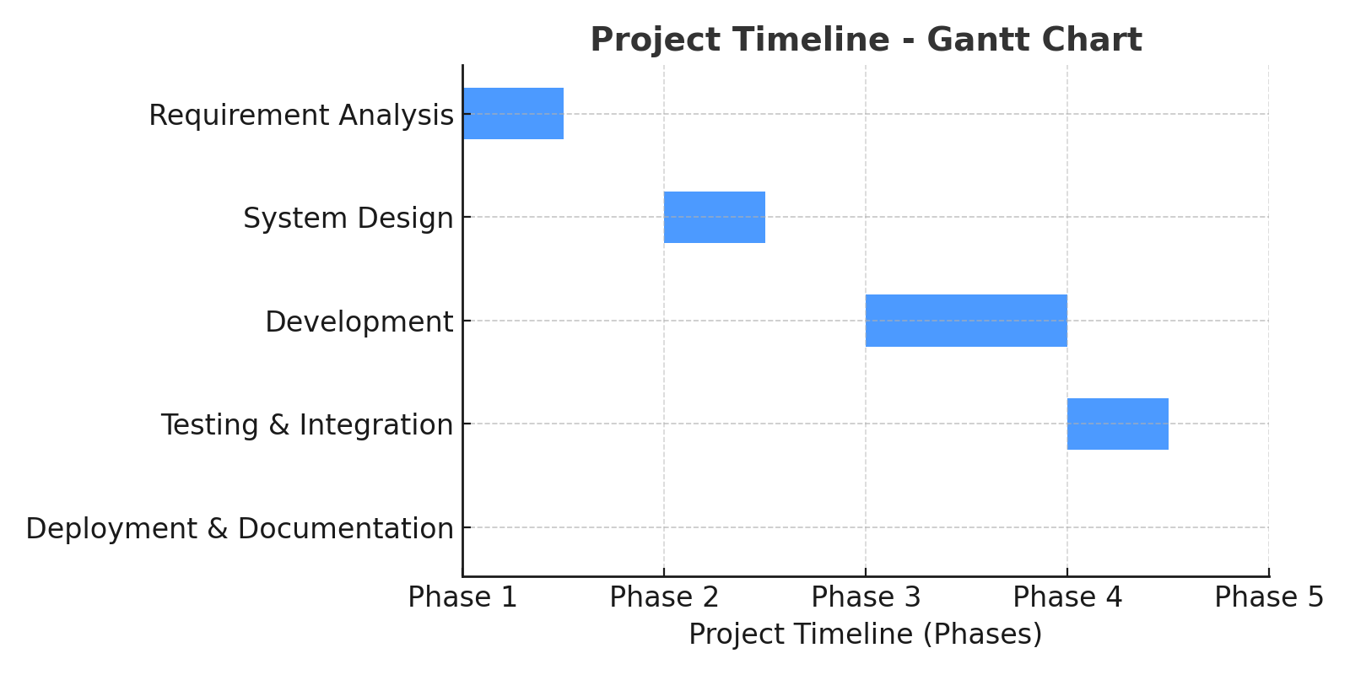
Timeline of the Project (Gantt Chart)

Slide 12
References (IEEE Paper format)
[1] M. S. Al-Ajlan and M. A. Al-Khalifa, "Towards the development of an automated evaluation tool for digital educational resources," International Journal of Advanced Computer Science and Applications (IJACSA), vol. 7, no. 7, pp. 204–210, 2016.
[2] N. G. T. Izquierdo, L. A. G. Villalobos, and J. D. M. Ramírez, "A framework for the evaluation of e-learning materials," in Proc. IEEE Global Engineering Education Conf. (EDUCON), Abu Dhabi, UAE, 2016, pp. 1129–1134.
[3] R. K. Singh and A. Sharma, "Design and development of web-based evaluation system for academic resources," International Journal of Computer Applications, vol. 183, no. 8, pp. 25–30, June 2021.
[4] T. M. Connolly and E. A. Stansfield, "Evaluating the quality of learning resources: A web-based approach," in Proc. IEEE International Conf. on Advanced Learning Technologies (ICALT), Athens, Greece, 2014, pp. 37–41.
[5] M. A. Al-Emran, "Towards an intelligent framework for textbook evaluation in higher education," Education and Information Technologies, vol. 24, no. 2, pp. 1453–1468, Mar. 2019.
[6] S. R. K. Somasekhar, P. V. Kumar, and R. J. Reddy, "Automated assessment of educational content using multi-criteria analysis," in Proc. IEEE International Conf. on Technology for Education (T4E), Mumbai, India, 2020, pp. 215–220.

Slide 13


